Slide 1
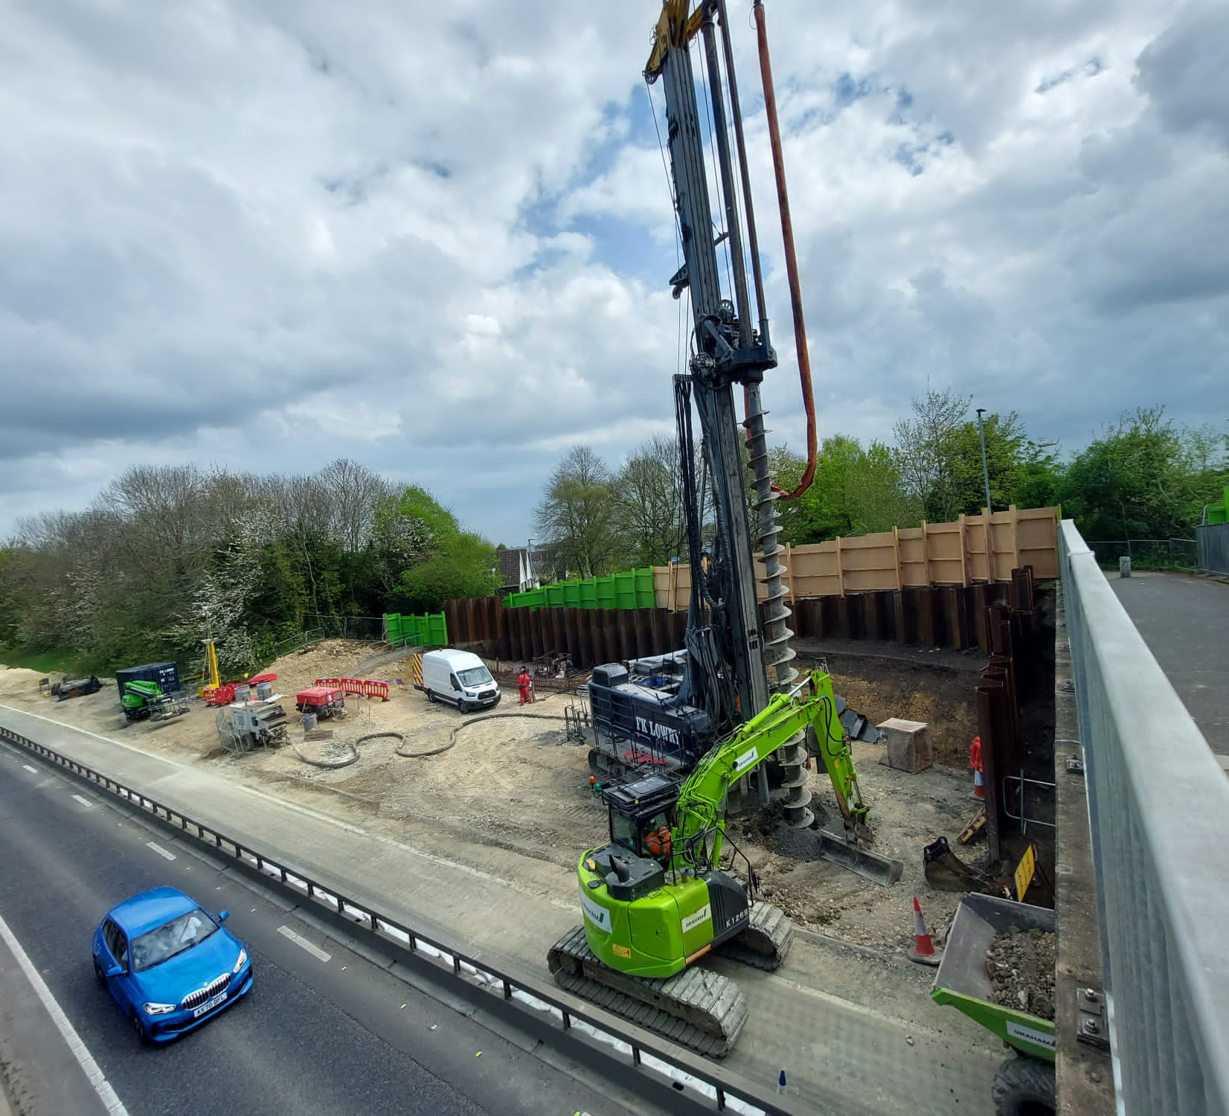

National Highways
East Region Maintenance and Improvement Programme
Simon Amor
Head of Scheme Delivery

Slide 2
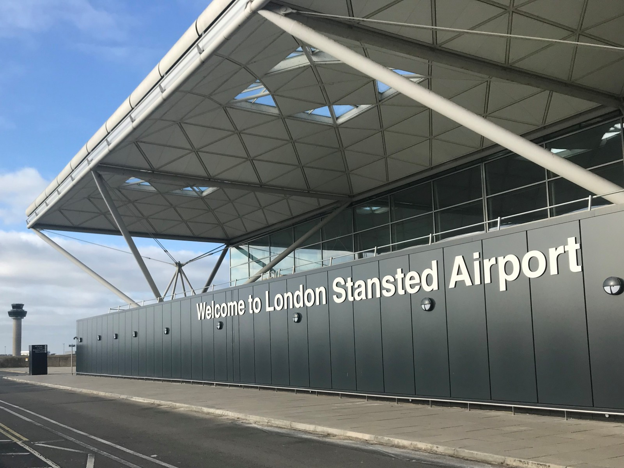
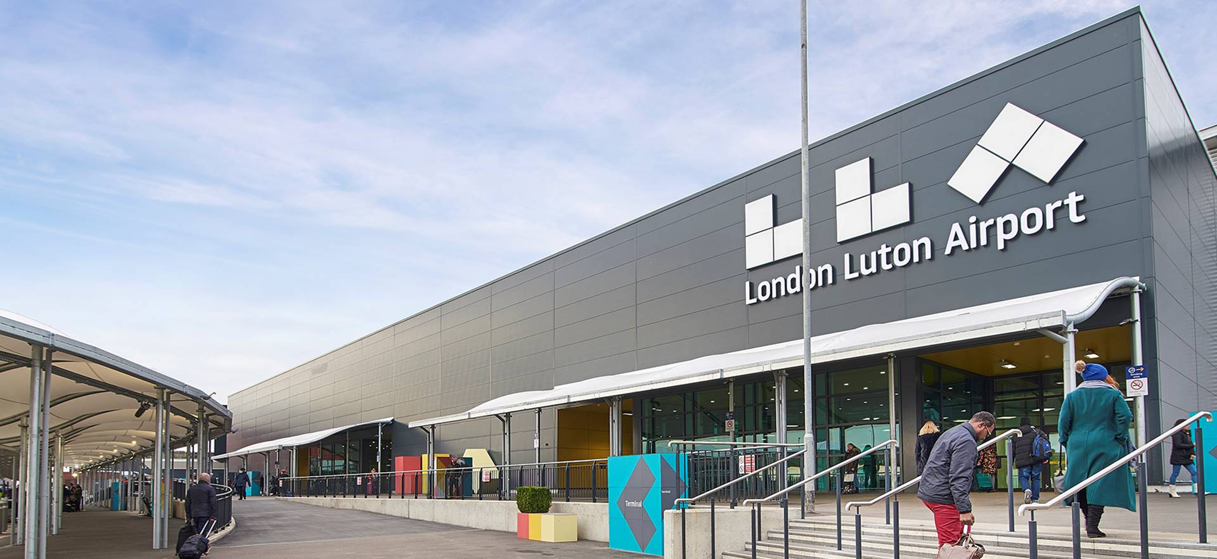
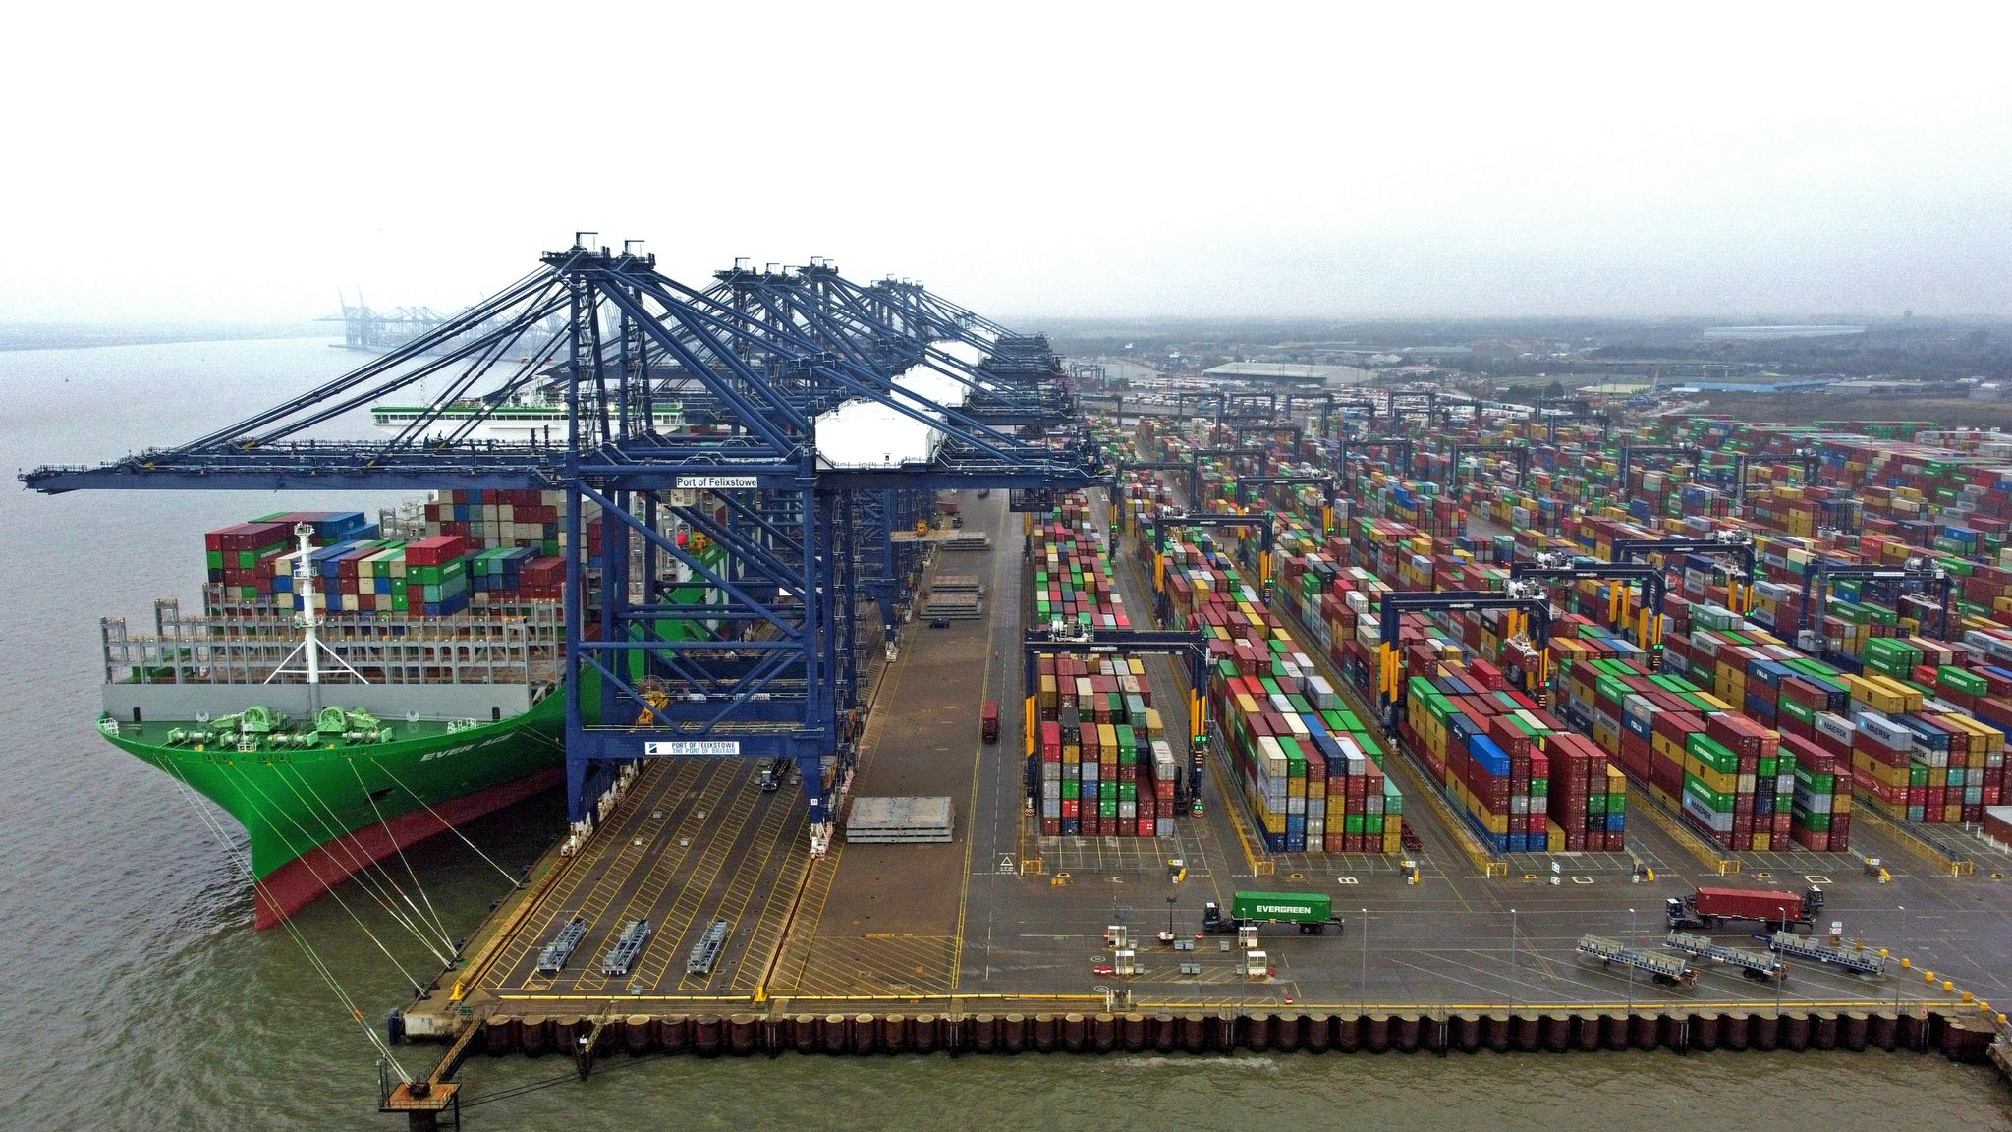
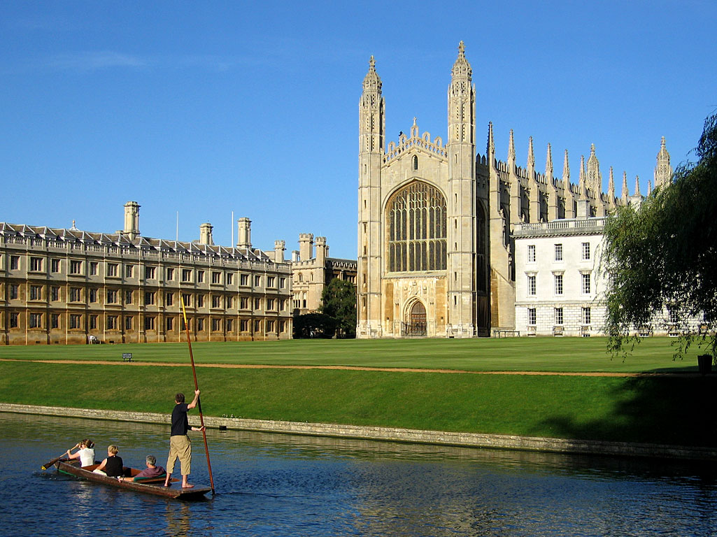
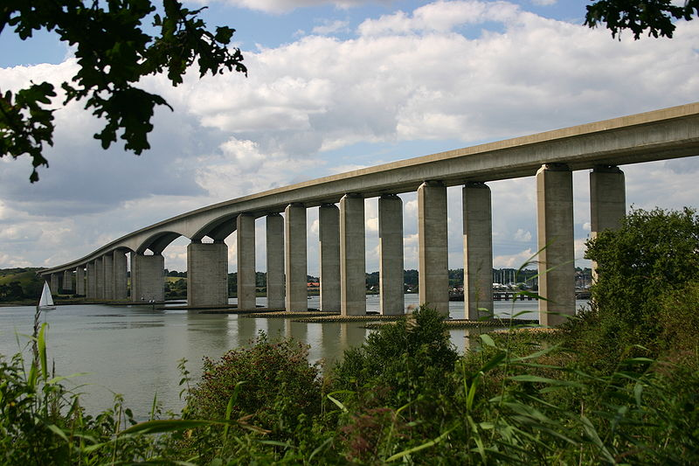
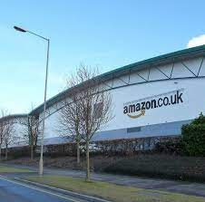
National Highways – East Region

Slide 3
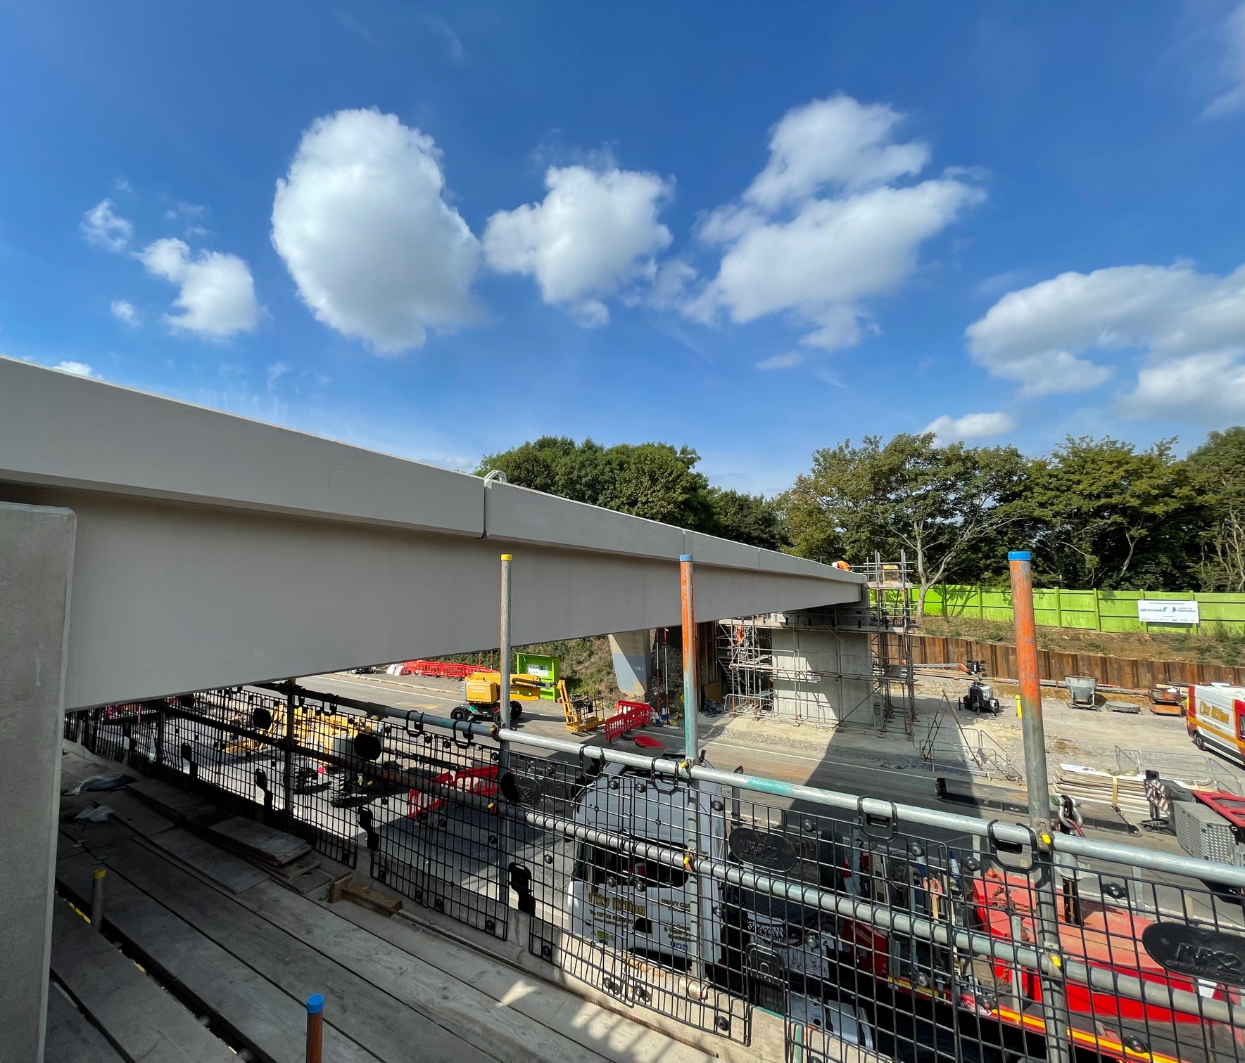
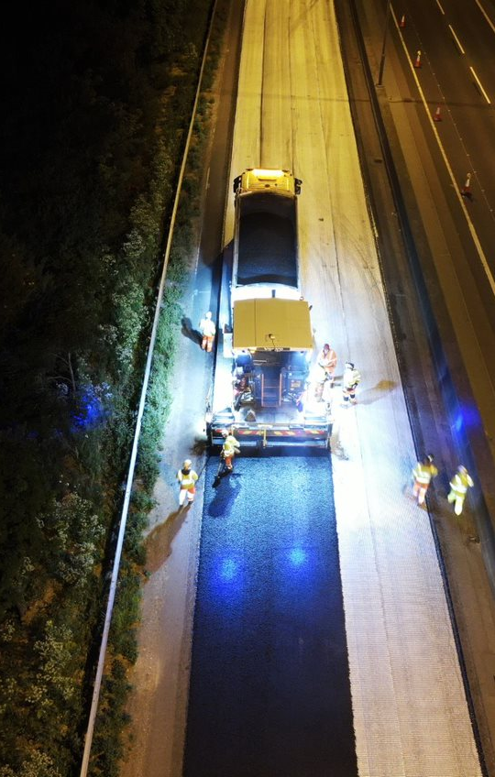
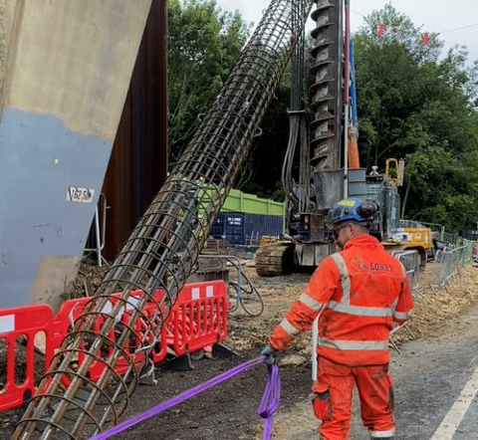
Regional Overview
Delivered over £200m of maintenance and small improvement schemes in the East in 2022/23
Pavement – 195 lane km
Total new pavement (195km) is equivalent to the length of the M25
Road markings – Over 849,000 metres, enough to cover the length of Stansted’s runway 275 times!
Drainage – 90,000 metres. Over 4 times the length of the River Orwell
Safety fence – 150,000 metres
Road studs - 64,500 - more than 2 studs for every seat in Portman Road

Slide 4
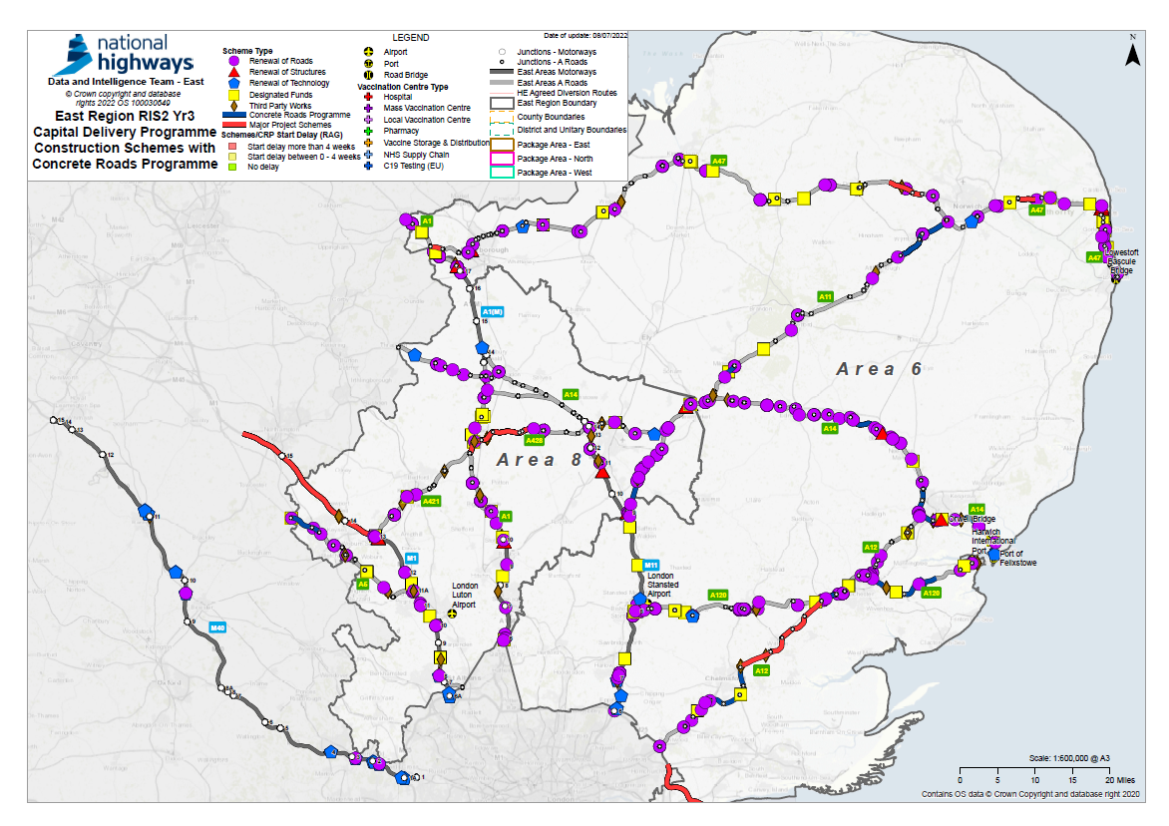
Programme of work to 2025

Slide 5
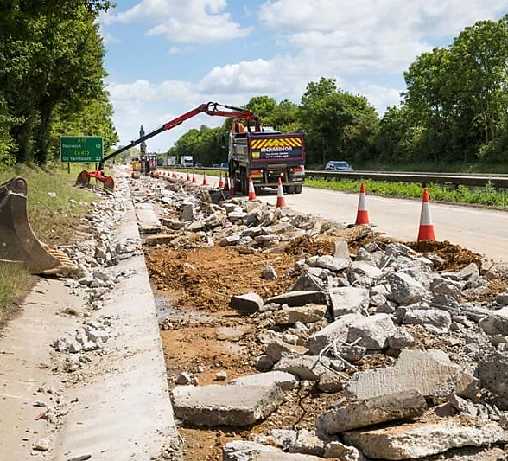
East Region Concrete Roads Programme

Slide 6
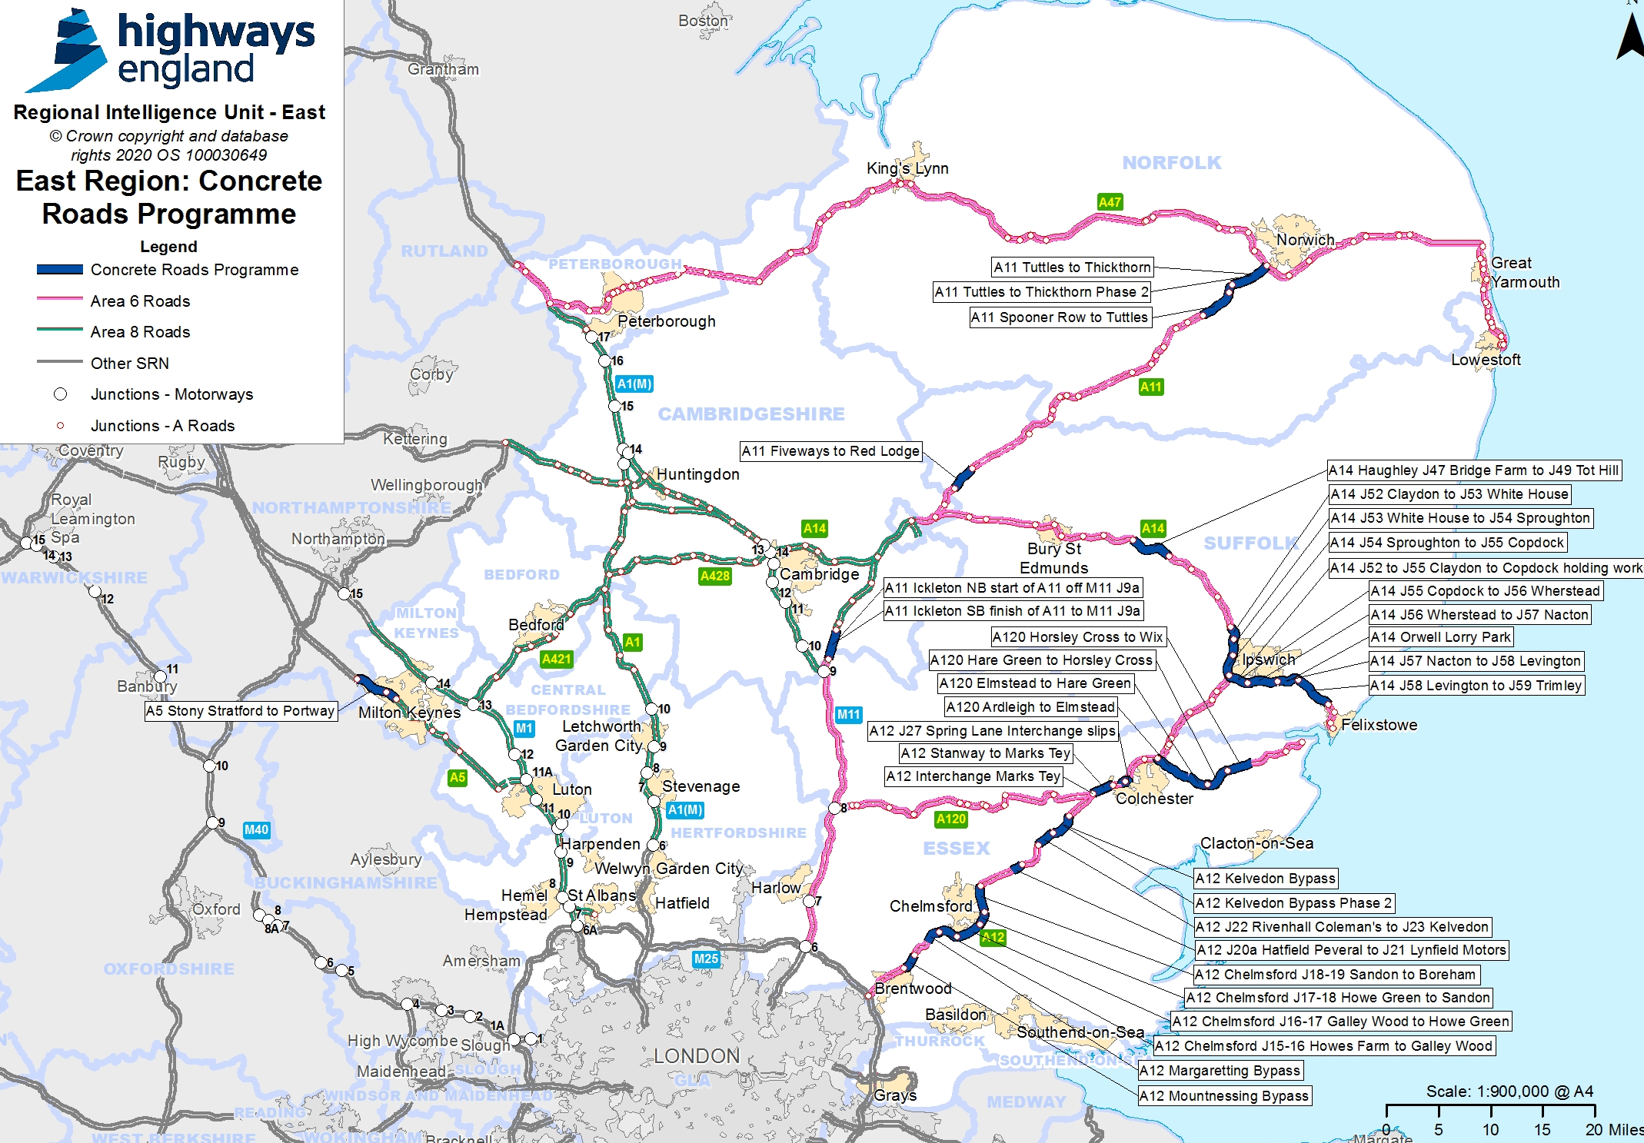
What are we doing?
Nearly £400m national investment programme
5% of the SRN made up of Concrete Roads
Some concrete roads are over 40 years old and are beyond end of life
East region has the highest concentration of concrete roads on our road network. Around 1/3 of national total.
Around half of the region’s concrete roads will be repaired or replaced over the next five years.

Slide 7
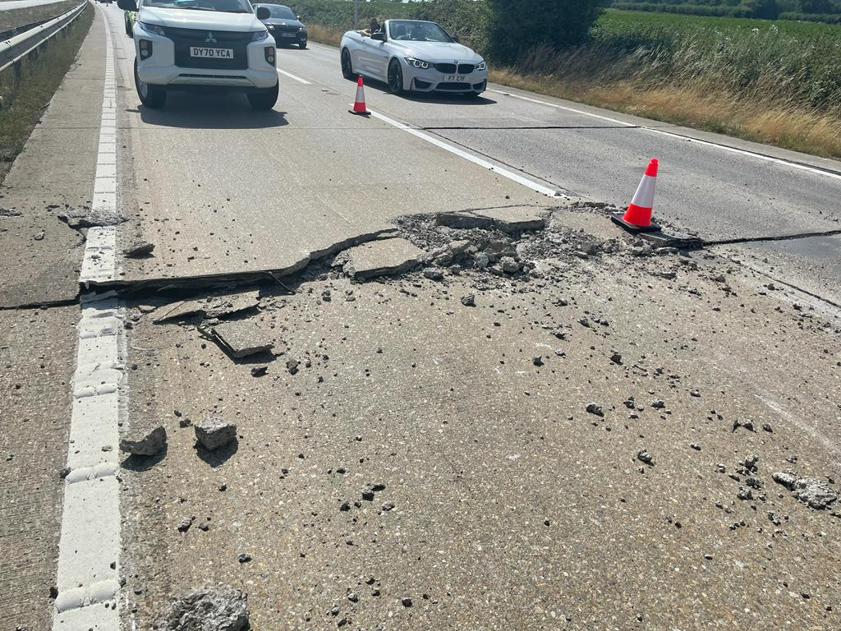
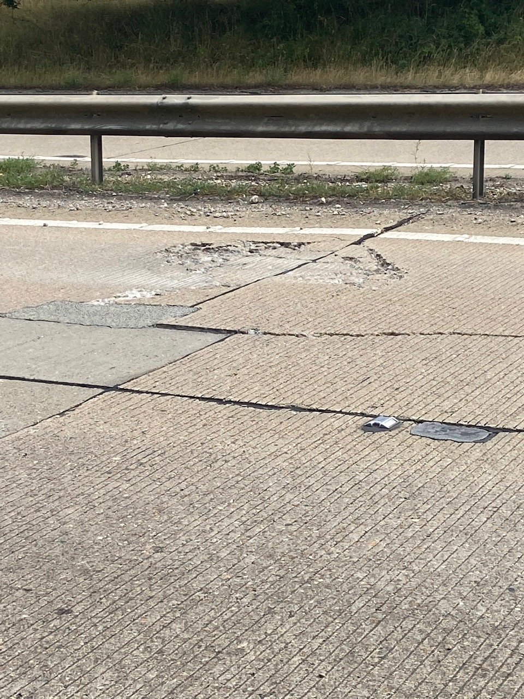
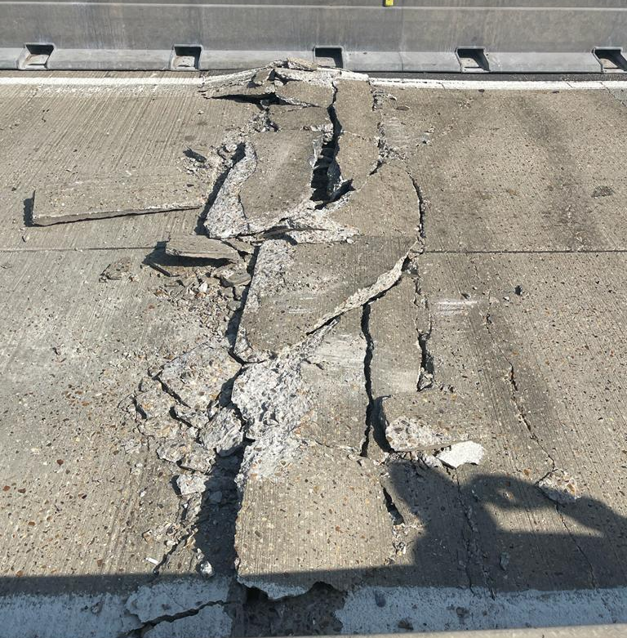
Why is the Concrete Roads Programme needed?

Slide 8
Reconstruction Schemes
Involves completely removing the concrete road surface and some of the foundations, before rebuilding the road and resurfacing it with a low noise surface (asphalt). It may also include barrier, drainage and signage works.
The roads are reaching the end of their serviceable life
Provides a 40 to 50-year lifespan that will be easier and quicker for us to repair in the future
Reconstruction schemes:
        A11 Wymondham, Norfolk – May 2022 to Summer 2023
        A12 Marks Tey to Stanway, Essex – October 2022 to Spring 2024
        A12 Margaretting Bypass, Essex – February 2023 to Summer 2024
        A14 Haughley to Tothill, Suffolk – March 2023 to Summer 2024

Slide 9

A14 Haughley – Tothill Scheme Extents & Scope
£37m investment
Full reconstruction of carriageway
Concrete removal and replacement with low noise asphalt surface
Replacement of safety barriers
New road markings and reflective studs (cat's eyes)
100% of material to be recycled
Scheme Extents

Slide 10
Programme
Preliminary Work – February 2023 to April 2023
  Overnight closures required for temporary carriageway repairs, vegetation clearance, CCTV installation, safety cameras and to build contraflow
Main Work – April 2023 to Summer 2024
  Full contraflow from mid April
  Breakout of concrete carriageway starts – eastbound first
  Switch of contraflow to opposite carriageway Autumn 2023
Work Complete - Summer 2024

Slide 11
Planned overnight closures: 8pm-6am
Date of overnight closures | Location of overnight road closures
Monday 20 March to Friday 24 March | A14 eastbound
Monday 27 March to Friday 31 March | A14 westbound
Monday 3 April to Wednesday 5 April | A14 eastbound
Tuesday 11 April to Friday 14 April | A14 westbound
Monday 17 April | A14 eastbound
Lane closures – key dates
Lane closures will be in place 24 hours a day from the following dates:
Eastbound – From 5am Friday 24 March until Tuesday 18 April
Westbound – From 5am Tuesday 28 March until Tuesday 18 April
Contraflow from 18 April

Slide 12
1+1 Contraflow – Running Lane Layout
A 1+1 contra-flow consists of two narrow lanes of two way traffic on one carriageway.
With the width of the existing carriageway in both directions being approximately 9.3m wide, a single lane in each direction is possible under a contra-flow traffic management technique.
This enables full access to the other carriageway to undertake the work.

Slide 13
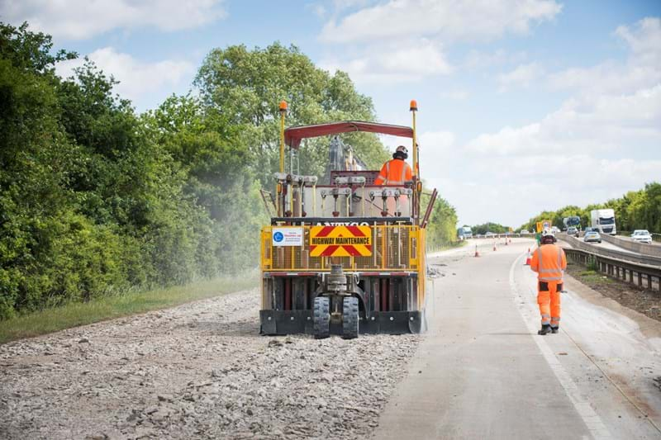
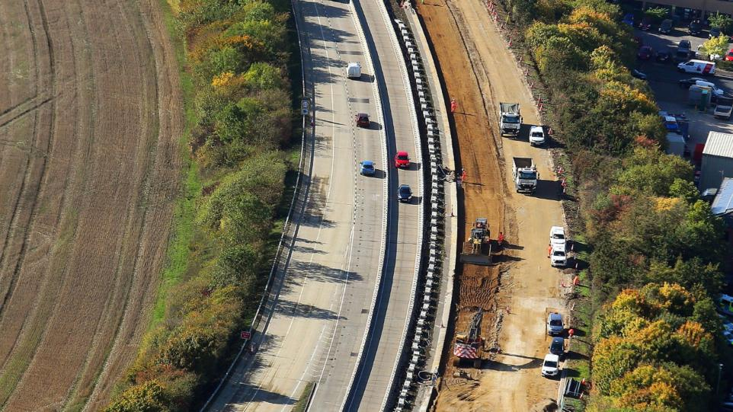
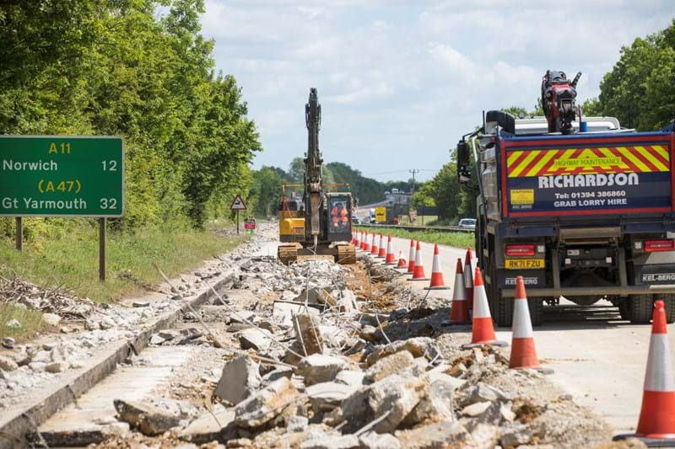
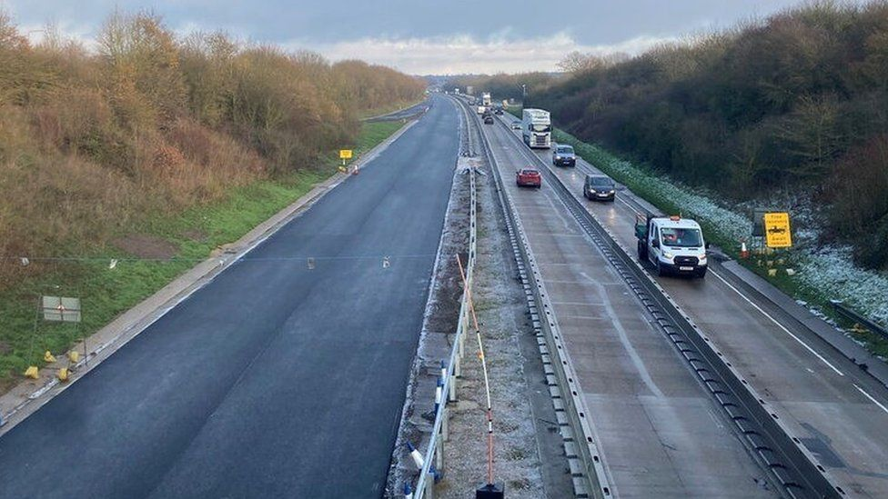
Concrete Carriageway Replacement

Slide 14
Communications
Meetings held with regional stakeholders - Felixstowe Port, Suffolk Chamber of Commerce, Road Haulage Association, Royal Mail, major hauliers, Felixstowe users group and others
Meetings with Suffolk County Council and elected Councillors
Meetings held with Suffolk Police and other emergency services
Public Information Events held October 2022 and January 2023
Information issued to hospitals, schools, local businesses
Information updated on National Highways website and on social media
Newsletter issued March 2023
Advanced signs placed along the A14

Slide 15
Continuing Communications
Further Public Information Events 30 and 31 March 2023, Stowmarket and Elmswell.
Letters sent in advance of construction to MPs, Councillors, Suffolk County Council and Parish Councils.
Scheme postcards and letters to be sent to local residents and businesses.
Scheme newsletter to be issued on a regular basis.
Stakeholder event to view the work.

Slide 16
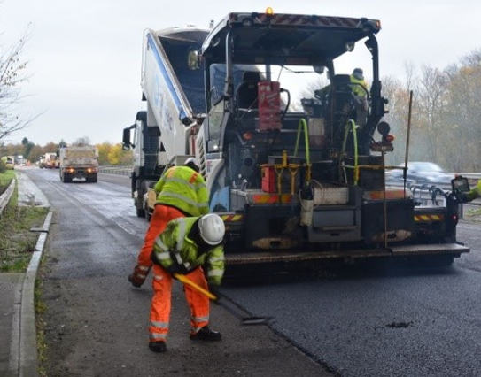
Significant benefits …
The schemes aim to: ​
  Provide safety benefits, as well as an improved ride and noise quality
  Reduce noise pollution for local residents
  Result in fewer closures for maintenance repairs, meaning more reliable journeys
  Help unlock future local growth, while also benefitting the wider economy
  Recycle 100% of removed material

Slide 17
Contact us:
www.nationalhighways.co.uk/A14Haughley - SMS service available
24/7 National Highways Customer Contact Centre on 0300 123 5000
Email to info@nationalhighways.co.uk
Road users can also keep up to date on road closures by visiting our Traffic England website at www.trafficengland.com or
Twitter: @HighwaysEAST / https://twitter.com/HighwaysEAST.

Slide 18

Any questions?

